Slide 1
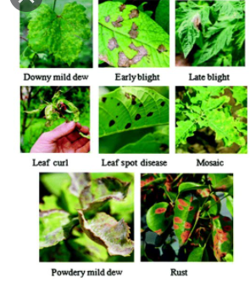
IMAGE BASED CROP DISEASE DETECTION USING CONVOLUTION NEURAL NETWORKS ALGORITHM
BY :
ABHITI LABROO 191225
KUNIKA SHARMA 191227

Slide 2
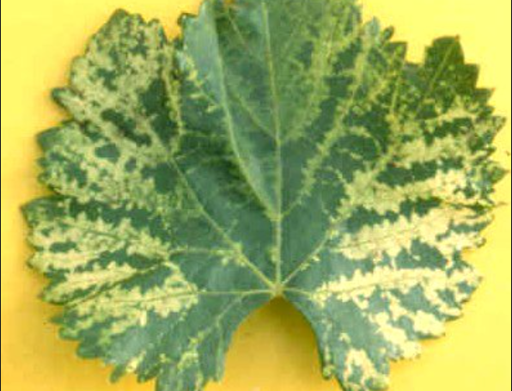
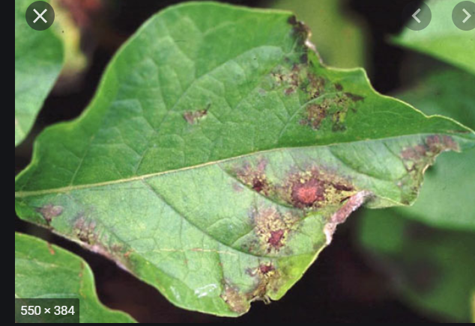
INTRODUCTION
The studies of plant disease refer to the studies of visually observable patterns on the plants. This requires large amount of work and also requires excessive processing time. The image processing techniques can be used in the plant disease detection.
Viral Disease Symptoms :
Leaves might be wrinkled, curled and growth may be stunted.
Bacterial Disease Symptoms :
The disease is characterized by tiny pale green spots which soon come
into view as water- soaked.

Slide 3
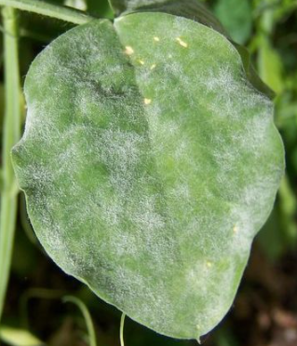
Fungal Disease Symptoms : White fungal growth appears on the leaf and it’s undersides.
PREVIOUS MODELS OF PLANT DISEASE DETECTION
Author Name | Techniques | Description
Sachin D. Khirade, A.B. Patil | K-means clustering | Discussed various plant leaf diseases & classification method
Sannakki et al. | Feed Forward Back Propagation Neural network | Discussed various plant leaf diseases & classification Method.
Kutty et al. | Neural Network | Neural network is used to classify watermelon leaf disease with accuracy 75.9%
P.R. Rothe, R.V. Kshiragar | Neuro-Fuzzy Inference System | Cotton leaf diseases of Alternarnia, Myrothecium and Bacterial are detected

Slide 4
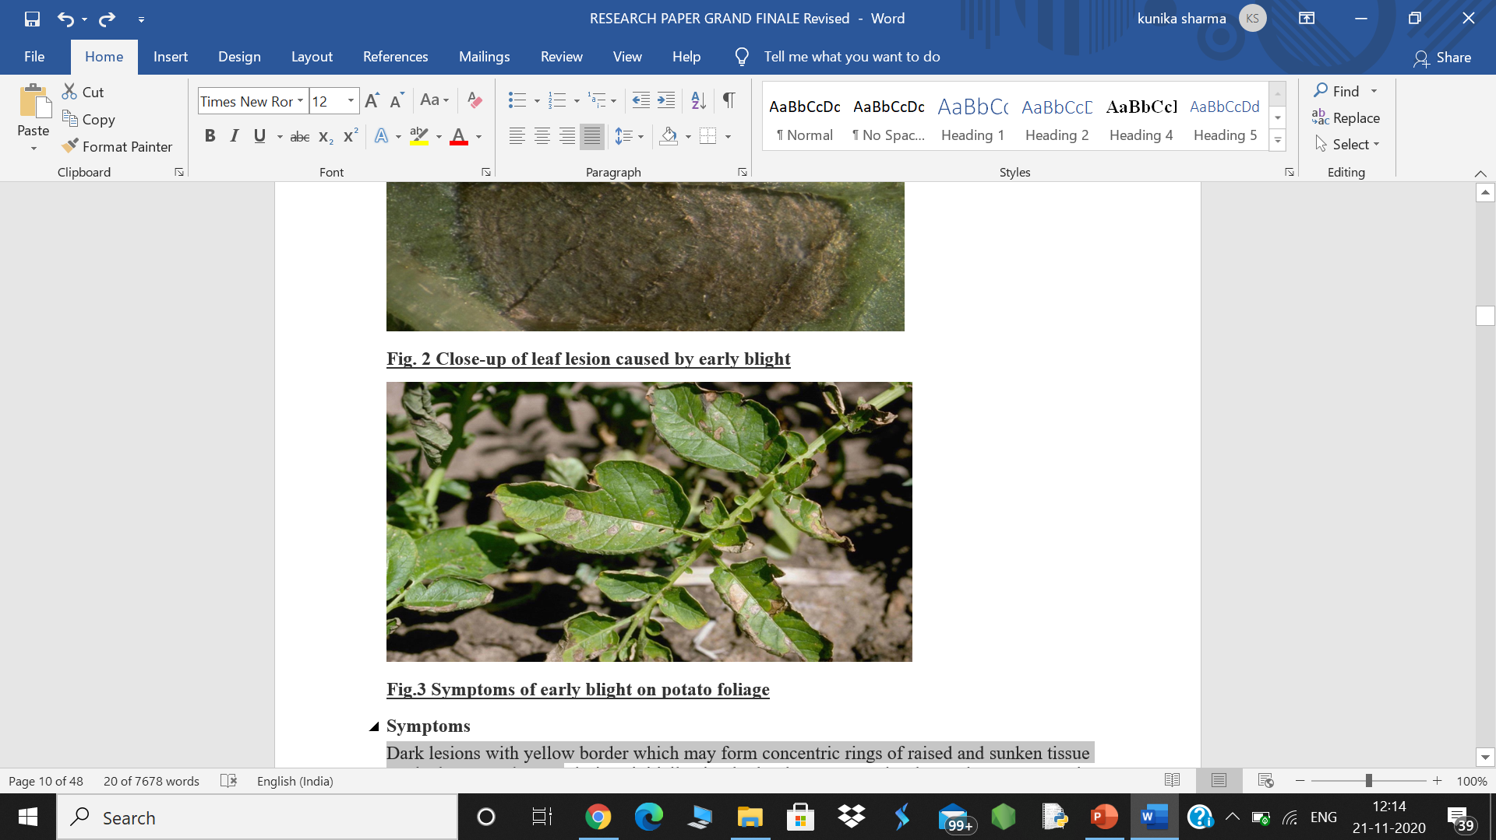
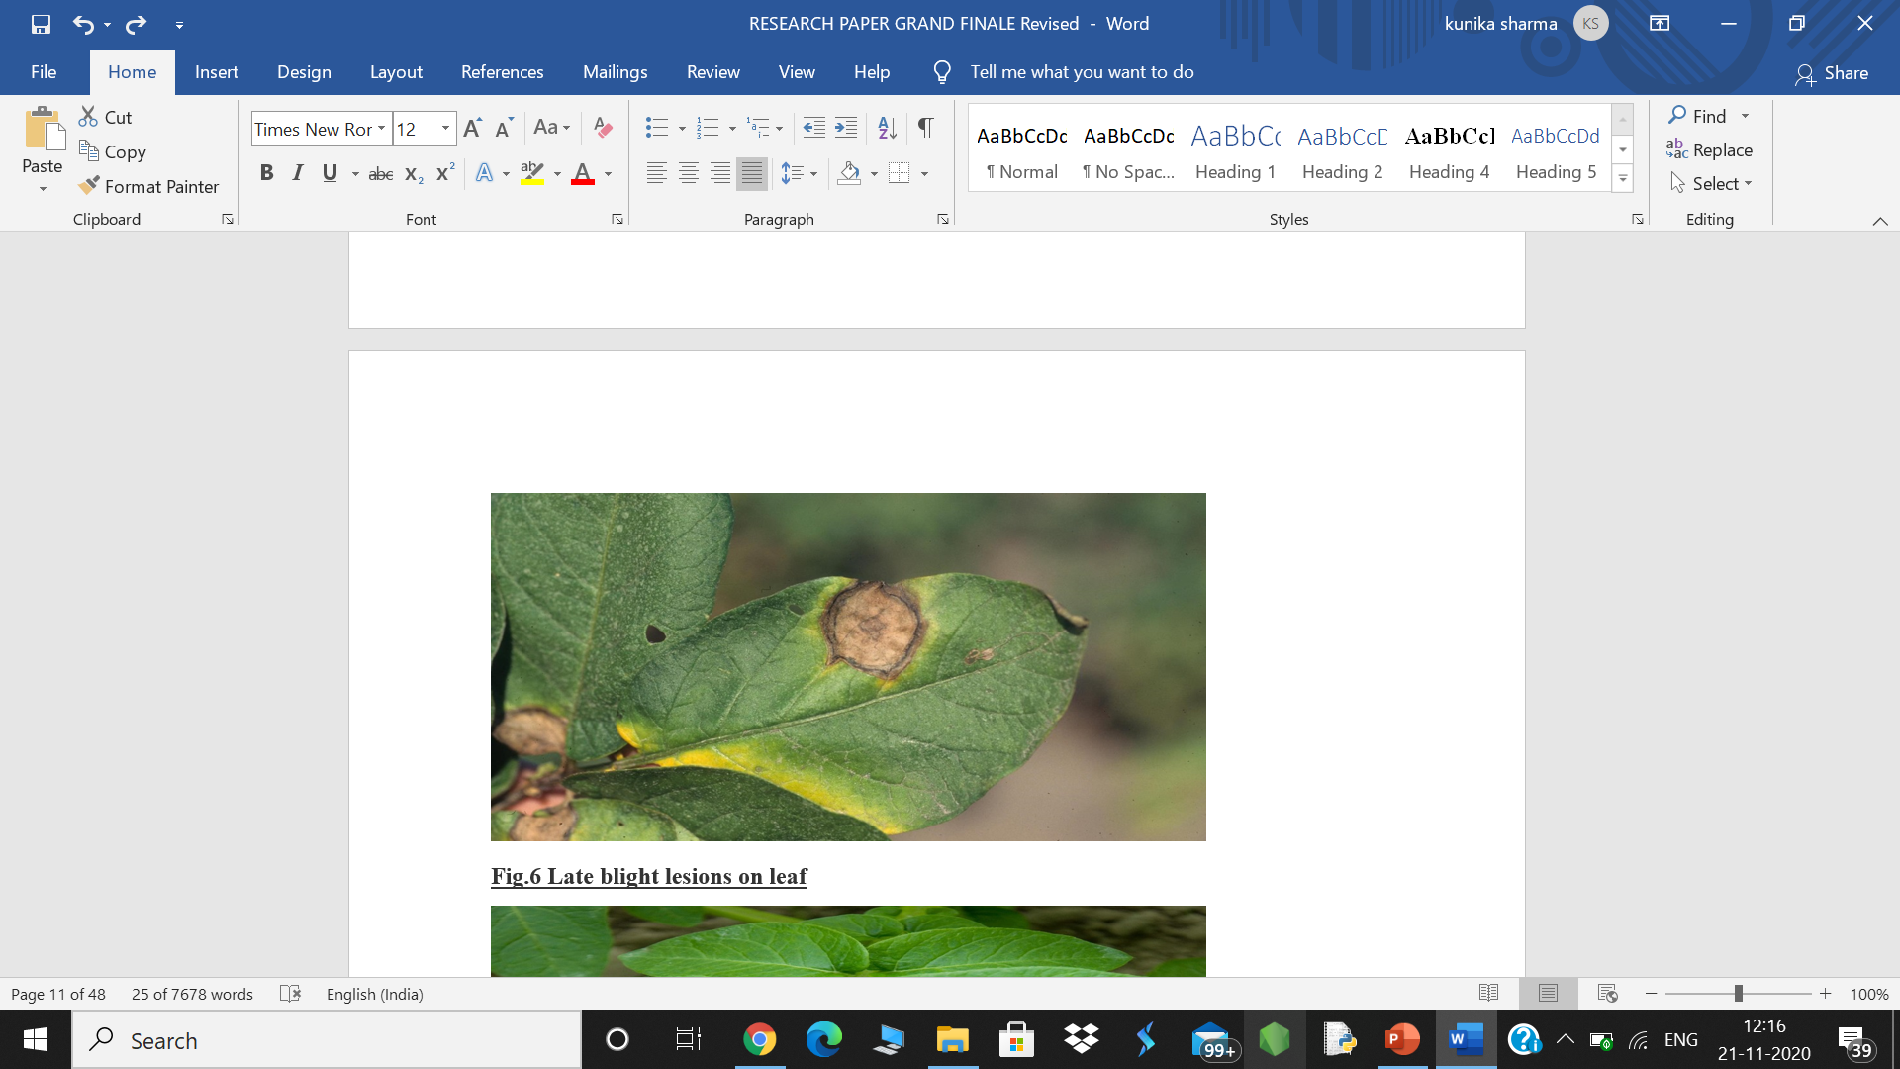
DATASET
Kaggle allows users to find and publish data sets, explore and build models in a web-based data-science environment.
This is where we extracted our dataset named PLANT VILLAGE and got started with our research on the leaf diseases of the Potato and Tomato. The author of the this dataset is Manikanta Munnangi, who is a research scholar from the Sri Ramaswamy Memorial Institute of Science and Technology, formerly SRM University.
POTATO : The potato plant has a branched stem and alternately arranged leaves consisting of leaflets which are both of unequal size and shape.
POTATO DISEASES :
1.Potato Early Blight: Dark lesions with yellow border which may form
concentric rings of raised and sunken tissue on the leaves and stems.
2.Potato Late Blight : The lesions dry up and go dark brown with
collapsed tissue; water-soaked dark green to brown lesions.

Slide 5
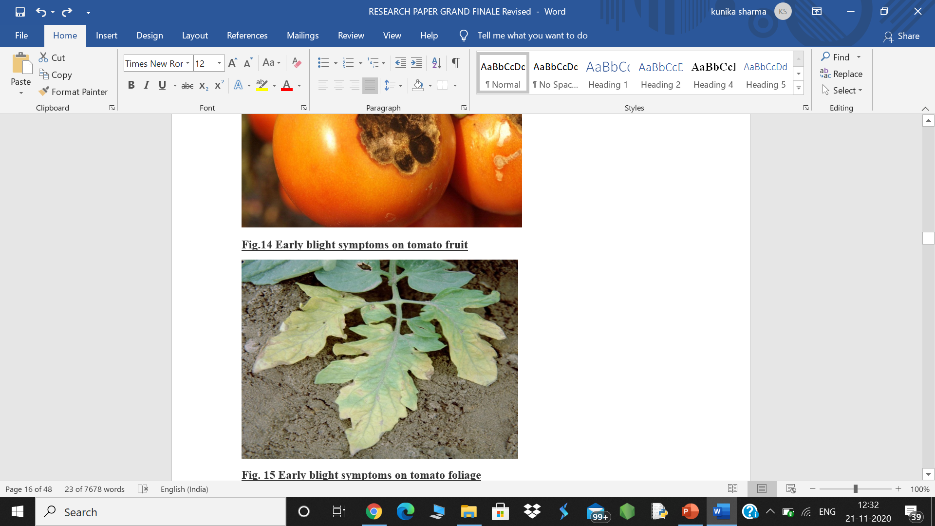

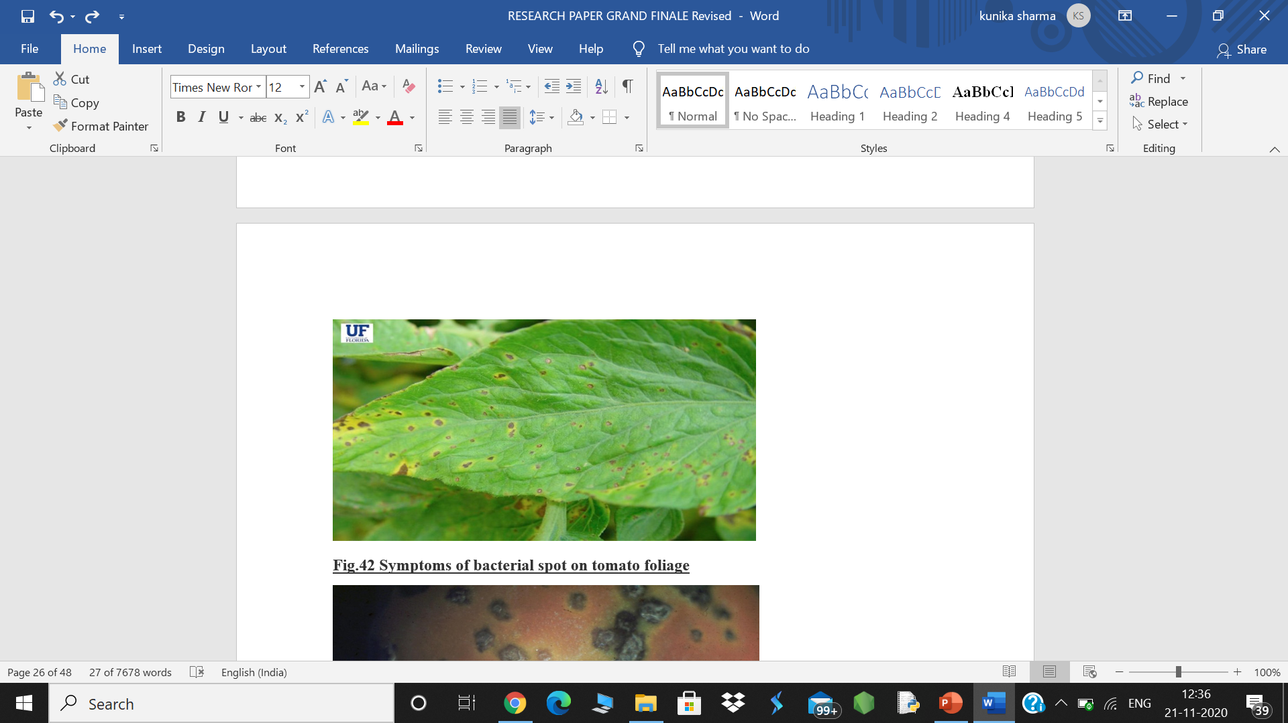
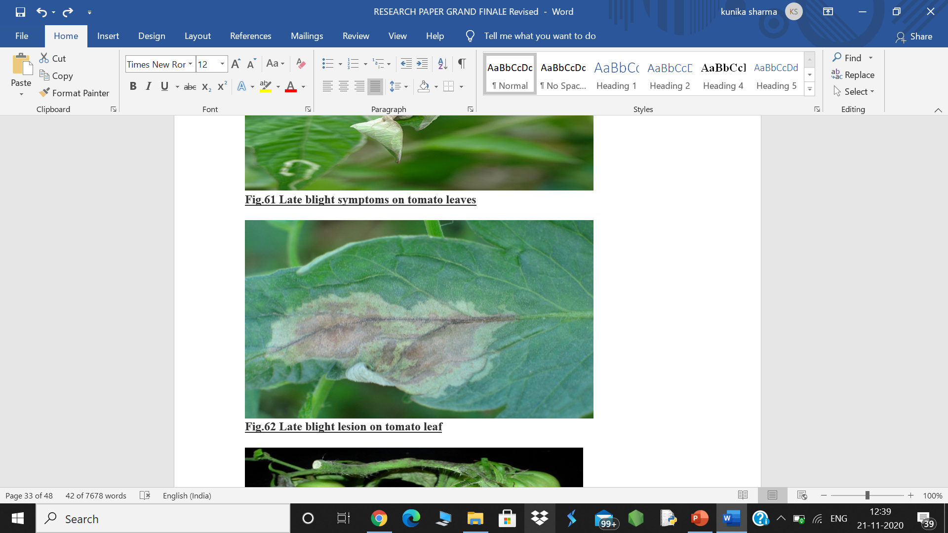
TOMATO : Tomato is an herbaceous annual in the family Solanaceae grown for its edible fruit. The plant can be erect with short stems or vine-like with long, spreading stems. The stems are covered in coarse hairs and the leaves are arranged spirally.
TOMATO DISEASES :
1. Early blight : Symptoms start as oval shaped lesions with a yellow
chlorotic region across the lesion; concentric leaf lesions may be seen on infected leaves.
2. Target Spot : Infected leaves shows small, pinpoint, water soaked spots initially.
As the disease progress the spots enlarge to become necrotic lesions with
conspicuous concentric circles, dark margins and light brown centre.
3. Bacterial spot : Bacterial spot lesions starts out as small water-soaked spots;
lesions become more numerous and coalesce to form necrotic areas on the leaves
giving them a blighted appearance.
4. Late blight : initial symptoms of the disease appear fluffy white fungal growth
may appear on infected areas and leaf undersides .

Slide 6
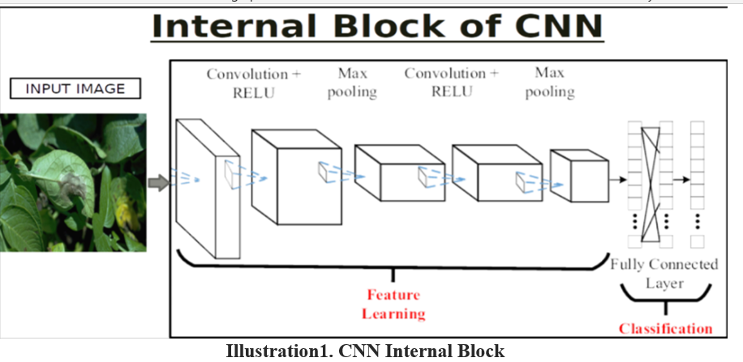
BACKGROUND AND PRELIMINARIES
Convolution Layer- CNNs comprise of filters or kernels or neurons that have learnable loads or parameters and inclinations.
ReLU Layer (Rectified Linear Unit) : We use this to introduce the non-linearity to CNN.
Pooling Layer (Max Pooling) : Pooling layer lessens the dimensionality of every activation map yet keeps on having the most significant data.
Flattening : We flatten our entire matrix into a vector like a vertical one. so, that it will be passed to the input layer.
Fully Connected- The last layers inside the system are fully connected, implying that neurons of preceding layers are associated with every neuron in resulting layers

Slide 7
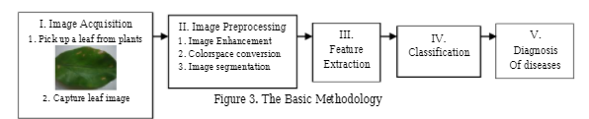
METHODOLGY
There are five main steps used for the detection of plant leaf diseases. The processing scheme consists of image acquisition through digital camera or web. Finally the presence of diseases on the plant leaf will be identified.
Image Acquisition
Image Pre-Processing
Image Segmentation
Feature Extraction
Classification & Detection of Diseases
Finally the presence of diseases on the plant leaf will be identified.

Slide 8
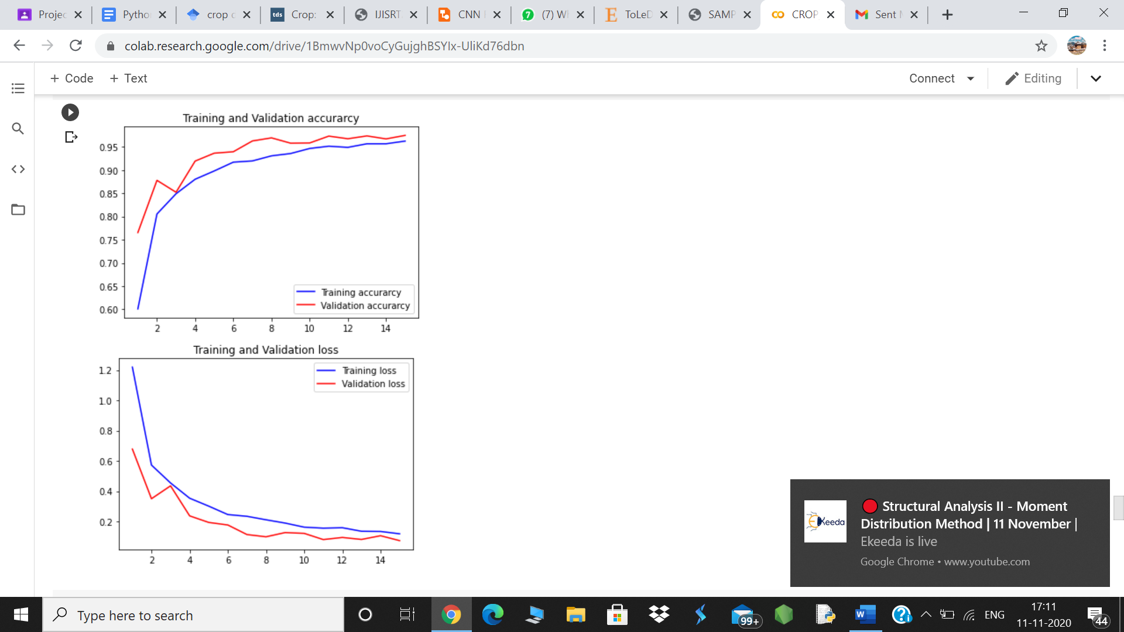
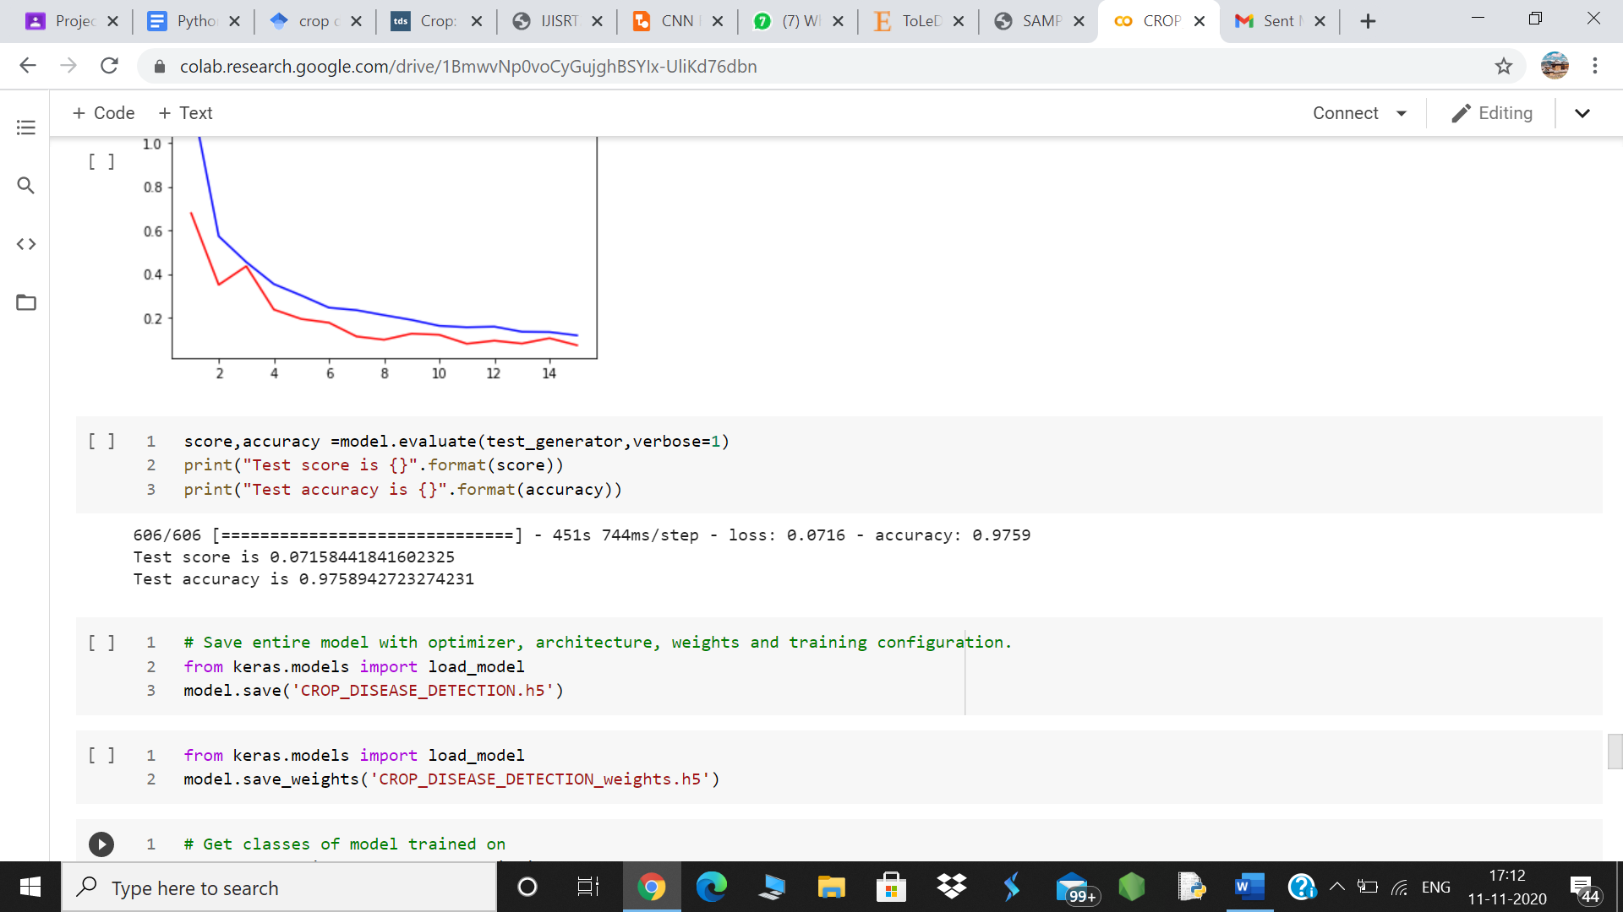
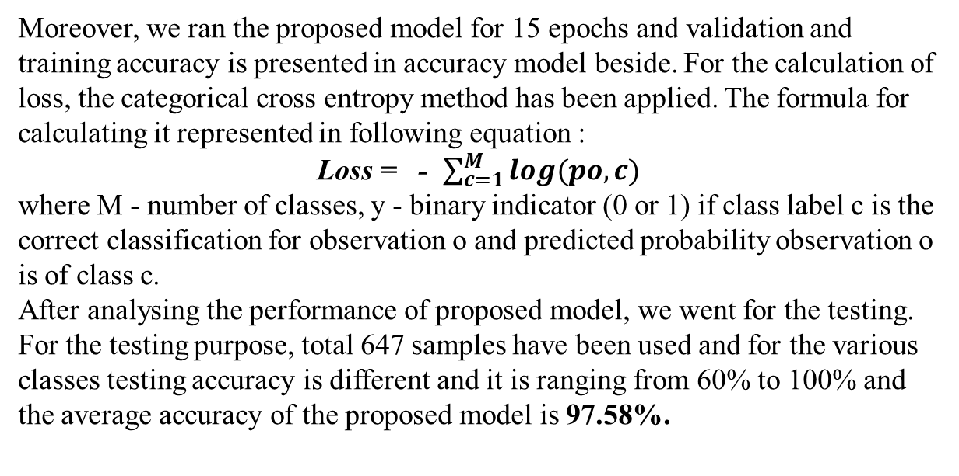
RESULTS AND DISCUSSIONS
Moreover, we ran the proposed model for 15 epochs and validation and training accuracy is presented in accuracy model beside. For the calculation of loss, the categorical cross entropy method has been applied. The formula for calculating it represented in following equation :
Loss = - $\sum_{c=1}^{M}{log(po, c)}$
where M - number of classes, y - binary indicator (0 or 1) if class label c is the correct classification for observation o and predicted probability observation o is of class c.
After analysing the performance of proposed model, we went for the testing. For the testing purpose, total 647 samples have been used and for the various classes testing accuracy is different and it is ranging from 60% to 100% and the average accuracy of the proposed model is 97.58%.

Slide 9
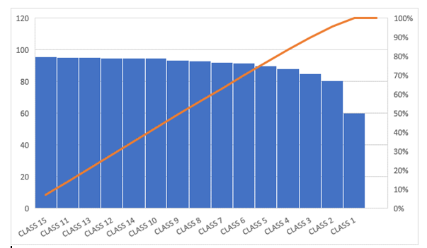
This histogram is used for analysing accuracy for each epoch class.
The proposed CNN project has been executed on GOOGLE COLAB which can be used as an interface to implement Deep leaning models using the CNN algorithm.
Hyperparameters for CNN in this model.
HYPERPARAMETER | DESCRIPTION
No. of convolutional layers | 3
No. of max pooling layer | 3
Activation function | Relu
No. of epoch | 15
Batch size | 64

Slide 10
CONCLUSION AND FUTURE WORK
CONCLUSION:
The present paper reviews and summarizes image processing techniques for several plant species that have been used for recognizing plant diseases. These techniques are used to analyses the healthy and diseased plants leaves. Some of the challenges in these techniques viz. effect of background data in the resulting image, optimization of the technique for a specific plant leaf diseases, and automation of the technique for continuous automated monitoring of plant leaf diseases under real world field conditions. The review suggests that this disease detection technique shows a good potential with an ability to detect plant leaf diseases and some limitations. Therefore, there is scope of improvement in the existing research
In the proposed work, we have developed a CNN based model to detect the disease in TOMATO and POTATO crop. In the proposed CNN based architecture there are 3 convolution and max pooling layers with varying number of filters in each layer. For the experiment purpose, we have taken the tomato and potato leaf data from Plant Village dataset.
As the images inside class is not balanced, so that data augmentation techniques have been applied to balance the images inside the class. Experimentally, it is observed the testing accuracy of the model is ranging from 60% to 100% for the classes. Moreover, the average testing accuracy of the model is 97.58%.

Slide 11
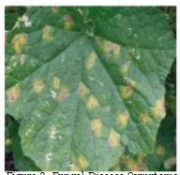
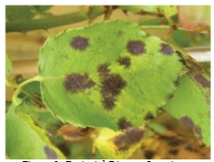
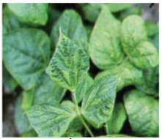
FUTURE WORK:
As a future work, we are trying to modify the model with a greater number of images with some other crop. Moreover, we are also in process to improve the same model on same dataset as testing accuracy is less. The severity of plant diseases changes with the passage of time, therefore, Deep Learning models should be improved/modified to enable them to detect and classify diseases during their complete cycle of occurrence.
As a future work, we are trying to modify the model with a greater number of images with some other crop. Moreover, we are also in process to improve the same model on same dataset as testing accuracy is less. The severity of plant diseases changes with the passage of time, therefore, Deep Learning models should be improved/modified to enable them to detect and classify diseases during their complete cycle of occurrence.
A comprehensive study is required to understand the factors affecting the detection of plant diseases, like the classes and size of datasets, learning rate, illumination, and the like.

